Slide 1
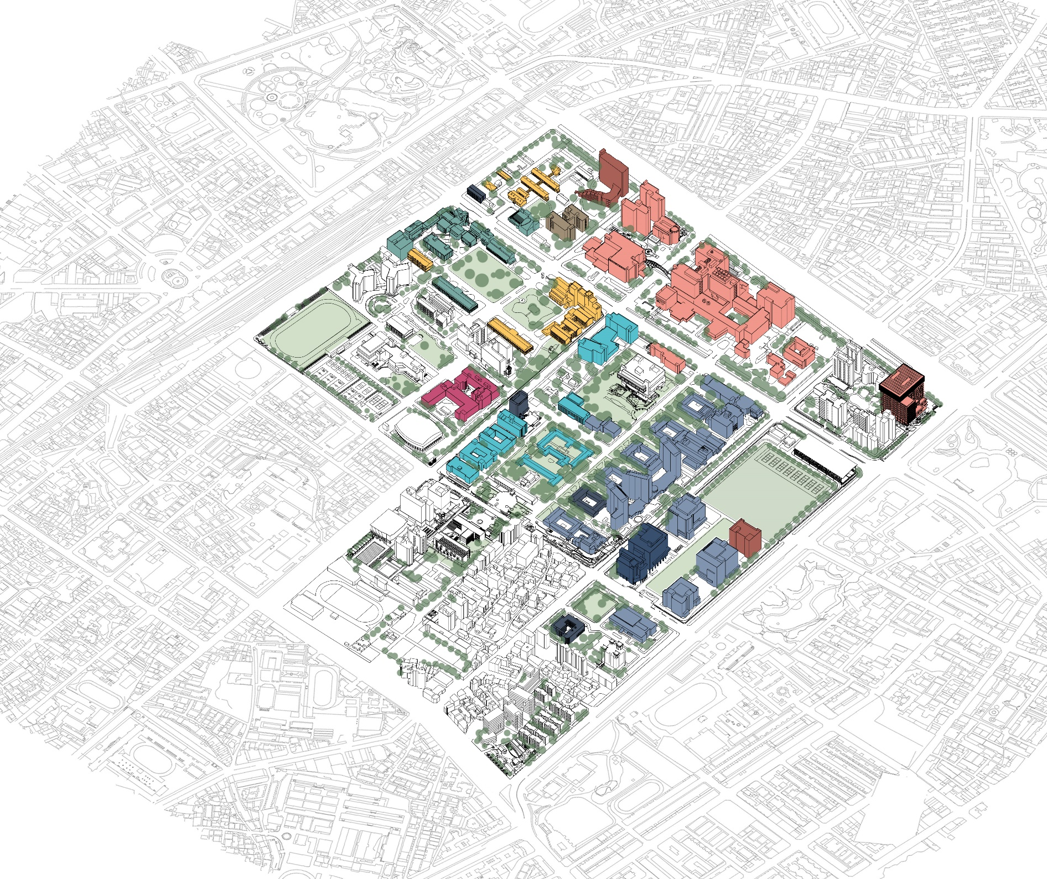
Topic
(Figure Here)
Proposer:
Date: Feb 02, 2022

Slide 2
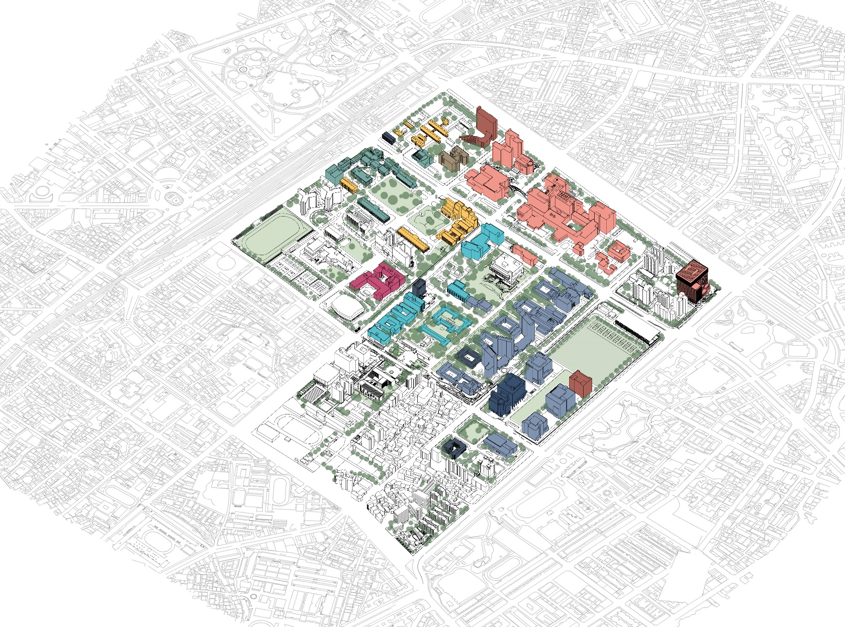
Type Title Text Here
(Figure Here)

Slide 3
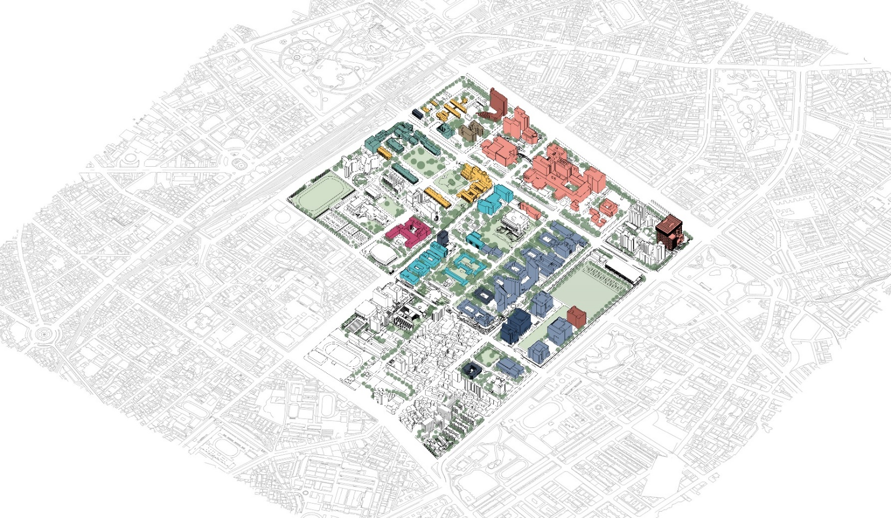
Type Title Text Here
Subtitle(Arial/24pt)
Item 1 (Arial/18pt)
Item 2
Item 3
Item 4
Item 5
Item 6

Slide 4
Type Title Text Here
Subtitle(Arial/24pt)
Content Text (Arial/14pt):
In academic publishing, a paper is an academic work that is usually published in an academic journal. It contains original research results or reviews existing results. Such a paper, also called an article, will only be considered valid if it undergoes a process of peer review by one or more referees (who are academics in the same field) who check that the content of the paper is suitable for publication in the journal.
This is particularly true for the most popular journals where the number of accepted articles often outnumbers the space for printing. Due to this, many academics self-archive a 'preprint' or 'postprint' copy of their paper for free download from their personal or institutional website.

Slide 5
Type Title Text Here
Subtitle(Arial/24pt)
Content Text (Arial/14pt):
In academic publishing, a paper is an academic work that is usually published in an academic journal. It contains original research results or reviews existing results. Such a paper, also called an article, will only be considered valid if it undergoes a process of peer review by one or more referees (who are academics in the same field) who check that the content of the paper is suitable for publication in the journal.
This is particularly true for the most popular journals where the number of accepted articles often outnumbers the space for printing. Due to this, many academics self-archive a 'preprint' or 'postprint' copy of their paper for free download from their personal or institutional website.

Slide 6

Type Title Text Here
Subtitle(Arial/24pt)
Content Text (Arial/14pt):
In academic publishing, a paper is an academic work that is usually published in an academic journal.
This is particularly true for the most popular journals where the number of accepted articles often outnumbers the space for printing. Due to this, many academics self-archive a 'preprint' or 'postprint' copy of their paper for free download from their personal or institutional website.
(Figure Here)
Figure note (Arial/9pt)

